Slide 1

Predictive Analytics for Interview Selection
Hackathon Organized by KPMG
Prithu Sharma Imarticus Learning, Jaipur

Slide 2
Problem Statement
Over 1 lakh interviews are annually conducted using an online platform. We need to develop an Intelligence tool that helps hiring managers, recruiters and HR to streamline recruitment process
Current Situation
Develop a robust predictive model that accurately determines the status of interviews based on the provided features.
identify potential biases and enhance overall recruitment processes.
Explore the features that contribute towards a successful and unsuccessful interview
Problem Scope
Evaluation Criteria
Model shall be evaluated based on its ACCURACY to predict the “status” of the Candidate on test dataset.

Slide 3
Project Workflow
1
5
Initial Evaluation on ML models
- No Hyperparameter tuning.
- Observing Accuracy on training and validation data.
Loading the Dataset
2
Data Cleaning - Removing Duplicate rows. - Handling Null Values.
Feature Selection - SelectKBest Method - Recursive Feature Elimination (RFE) - Feature importance from RandomForestClassifier
6
Event
3
Exploratory Data Analysis - Visualize the data.
- Gather insights regarding specific features and Data Preprocessing.
7
Hyperparameter tuning on selected ML models using GridSearchCV to get the best model.
4
Data Preprocessing - Encoding Categorical Features using Ordinal and One Hot Encoding. - Feature Scaling using MinMaxScaler.
8
Taking predictions on the “TEST” data using the Best models.

Slide 4
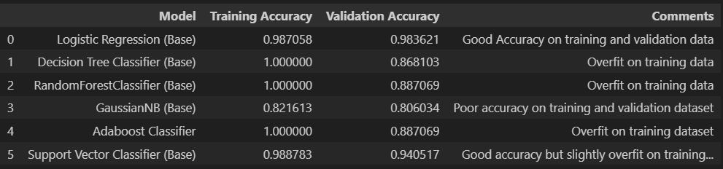
Initial Evaluation on Base Models
Evaluating training and validation accuracies on a few classification models
Observations:
Linear models such as Logistic Regression and SVC performed better than Tree Based models Decision Tree and Random Forest Classifier.
Notes:
Initial model results

Slide 5
Feature Selection
Random Forest Classifier
SelectKBest
(chi2)
RFE
Best Features: L.M.C
L.J.T.C
N.I.C
S.P.C
Interview duration
L.A.C
Best Features: L.M.C
L.J.T.C
N.I.C
S.P.C
L.A.C
Interview duration
Best Features: L.J.T.C
S.P.C
L.M.C
N.I.C
Interview duration
L.J.T.I
L.M.C: Longest Monologue Candidate
L.J.T.C: Late Joining time Candidate
N.I.C: Noise Index Candidate
S.P.C: Speaking Pace Candidate
L.A.C: Live Absence Candidate
Final Selected Features: L.M.C, L.J.T.C, N.I.C, S.P.C, L.A.C, Interview duration

Slide 6
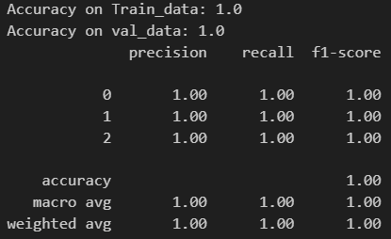
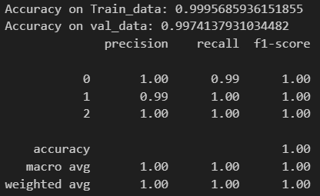
Best Models after Hyperparameter Tuning
Logistic Regression
Support Vector Classifier (SVC)
HyperParamters:
max_iter = 1500 class_weight = ‘balanced’ solver = ‘liblinear’
HyperParamters:
kernel = ‘linear’
max_iter = 75000 class_weight = ‘balanced’
Test Data Score
70.83
Note: Both models were run on scaled data and only the important features were used for evaluation purpose.

Slide 7
Thank You

